Slide 1
Employee Churn Analysis
1. Questions
- The HR department at Salifort Motors wants to take some initiatives to improve employee satisfaction levels at the company.
- They have the following question: what’s likely to make the employee leave the company ?

Slide 2
Employee Churn Analysis
1. Exploratory Data Analysis
- The dataset has 10 columns:
+ Numeric variables: satisfaction_level, last_evaluation, number_project, average_monthly_hours, time_spend_company, Work_accident, left, promotion_last_5years.
+ Categorical variables: Department, salary.
- Cleaning dataset:
+ Dropped 0 rows containing nulls
+ Removed 3008 duplicate rows
+ Column 'Department': trimmed 0 values
+ Column 'salary': trimmed 0 values
+ Column 'Department': standardized 1670 values
+ Standardized 2 column names to lowercase (Work_accident, Department)

Slide 3
Employee Churn Analysis
1. Exploratory Data Analysis
- Find outliers: create boxplot & plot boxplot.
column | Q1 | Q3 | IQR | Lower Bound | Upper Bound | Outlier Count
number_project | 3.0 | 5.0 | 2.0 | 0.0 | 8.0 | 0
average_monthly_hours | 157.0 | 243.0 | 86.0 | 28.0 | 372.0 | 0
time_spend_company | 3.0 | 4.0 | 1.0 | 1.5 | 5.5 | 824

Slide 4
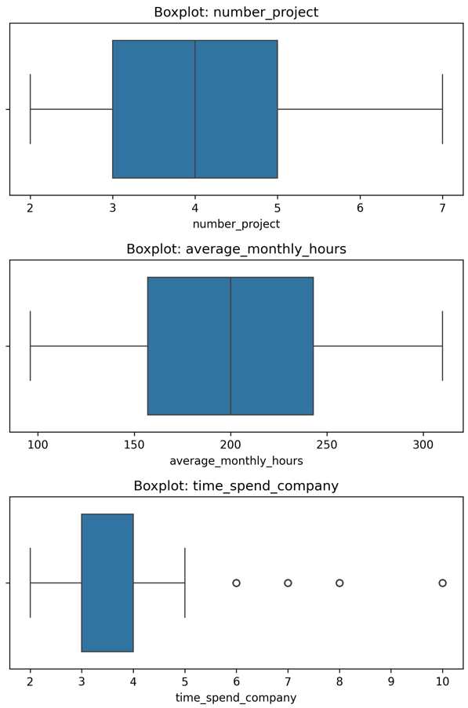
Employee Churn Analysis
1. Exploratory Data Analysis
Remove outliers when we build logistic model.

Slide 5
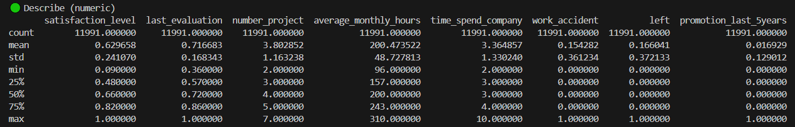
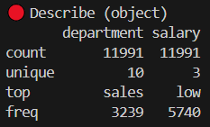
Employee Churn Analysis
1. Exploratory Data Analysis
- According to the data below, all value of each column has a reasonable distribution.

Slide 6
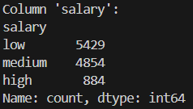
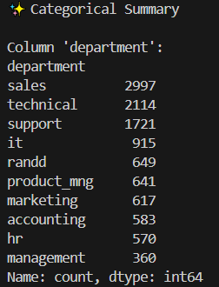
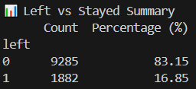
Employee Churn Analysis
Exploratory Data Analysis
There are 10 departments.
Sales is the most represented department, whereas Management is the least represented.
In the Salary column, low and medium salaries account for the majority.
Finally, there are 2 unique values in the target column: left (83.15%) & stayed (16.85%).

Slide 7
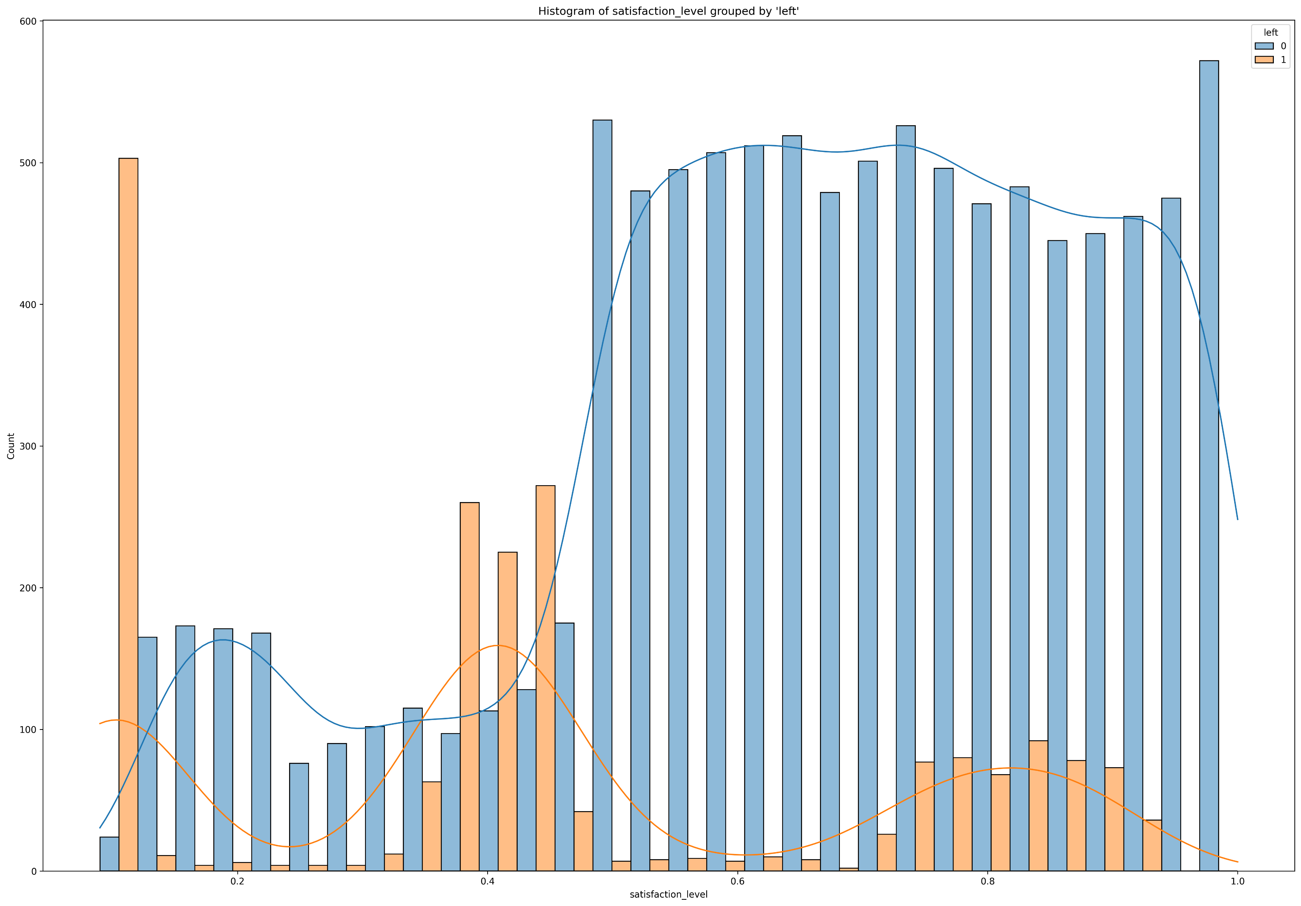
Employee Churn Analysis
Exploratory Data Analysis
- Histogram of satisfaction_level.
- High churn rate when
satisfaction is low.
- Even high satisfaction has
churn rates.
- At average satisfaction level
still have high churn rate.

Slide 8
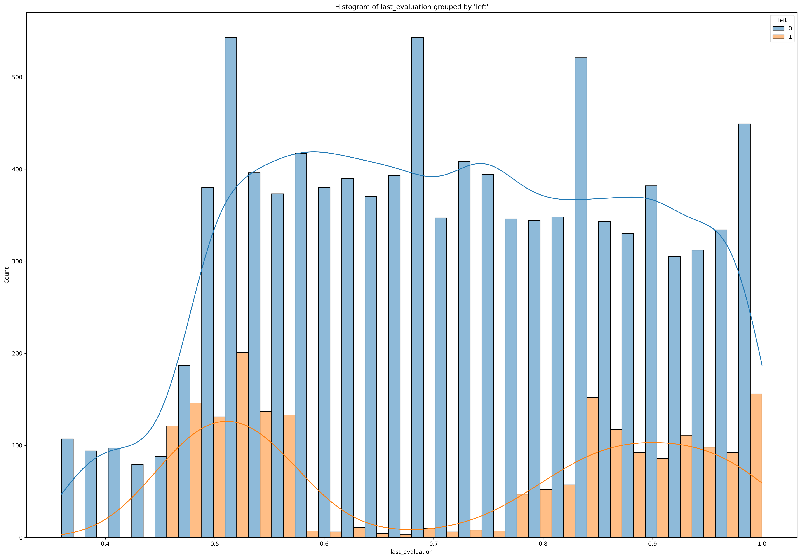
Employee Churn Analysis
Exploratory Data Analysis
- Histogram of last_evaluation.
- High churn rate when
evaluation score is high.
- At average evaluation score
still have high churn rate.

Slide 9
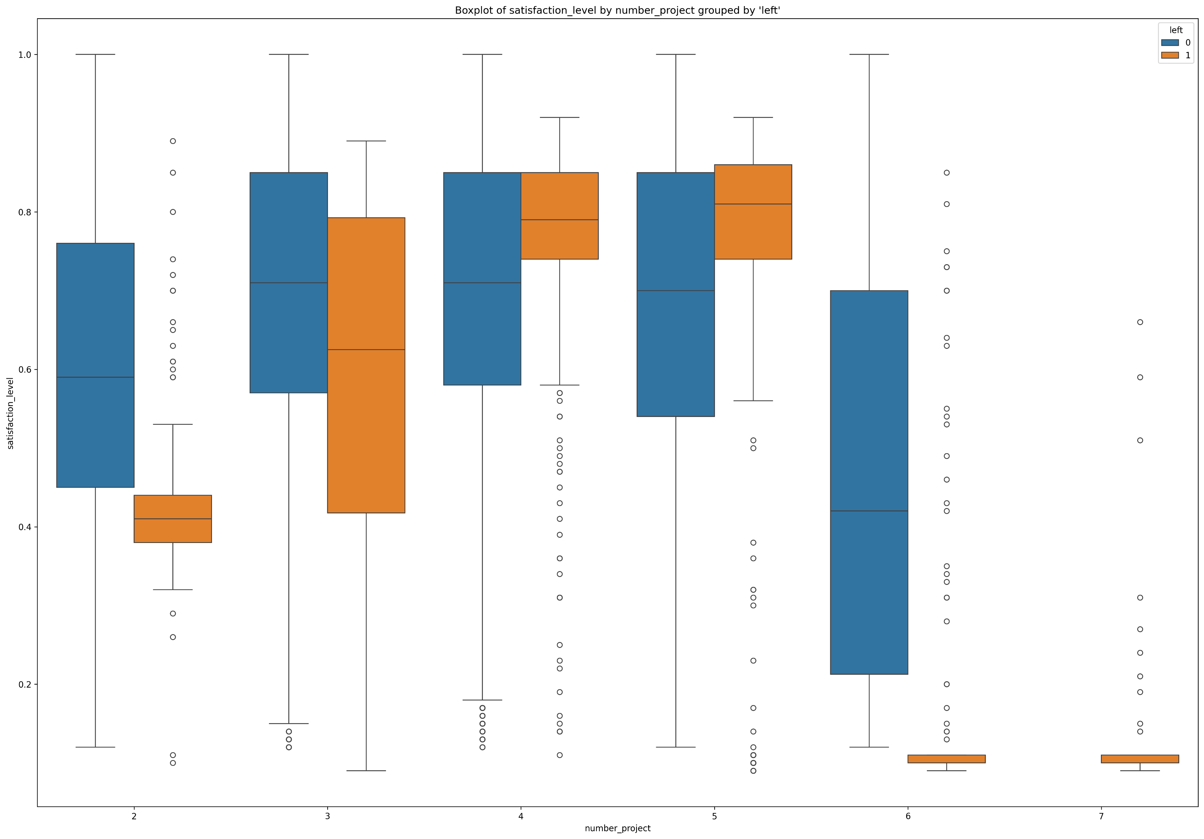
Employee Churn Analysis
Exploratory Data Analysis
- Boxplot of number_project
and satisfaction_level.
- The churn rate increases
linearly between the 2 variables.
-With 3 projects, employee
attrition is highest, although
satisfaction is quite high.
- With 7 projects, all left.

Slide 10
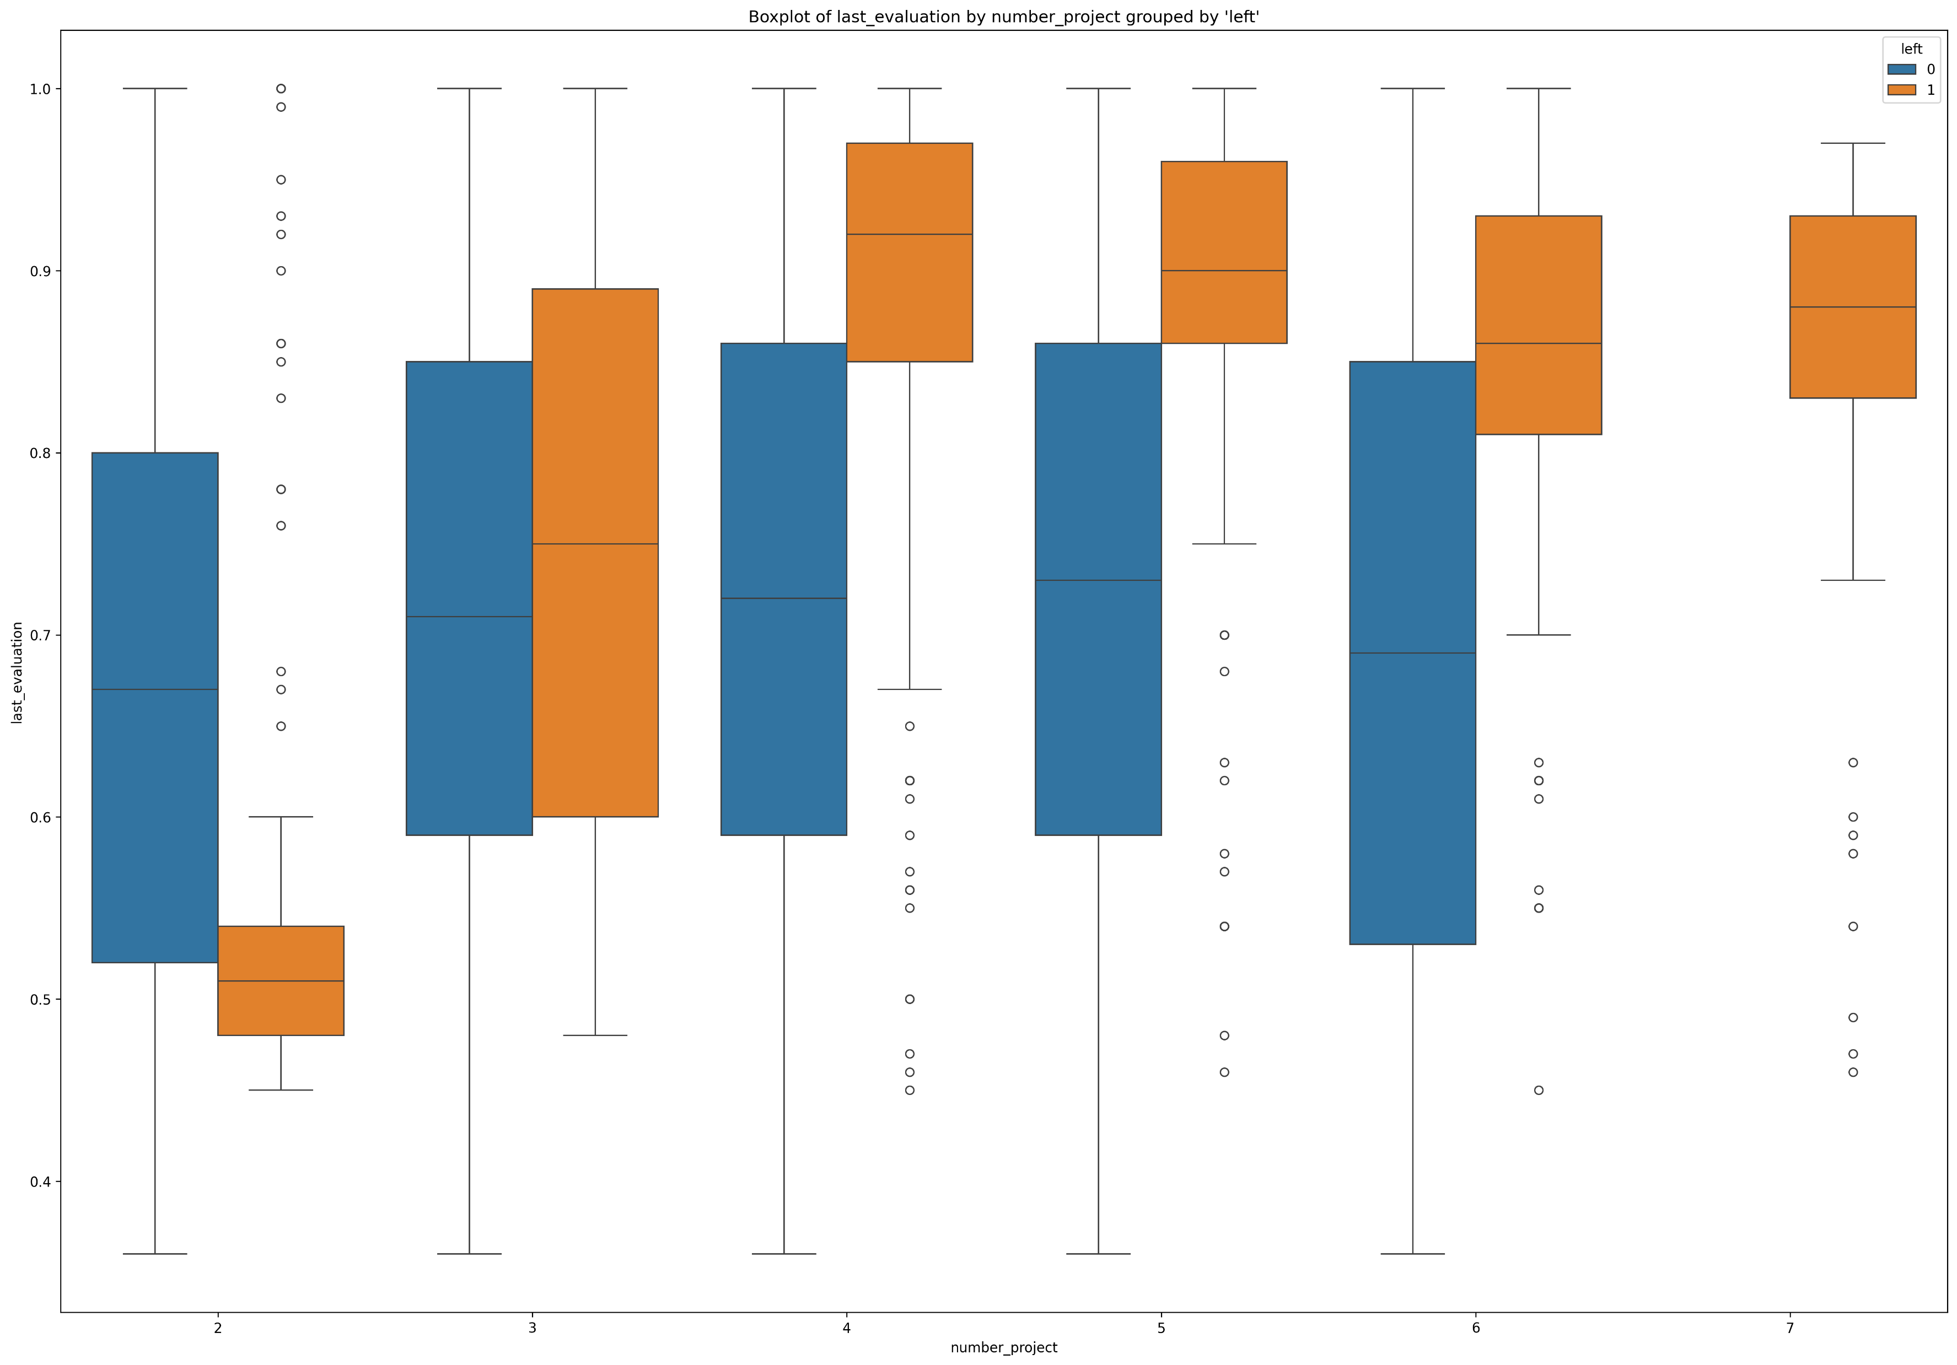
Employee Churn Analysis
Exploratory Data Analysis
- Boxplot of number_project
and last_evaluation.
- The churn rate increases
linearly between the 2 variables.
- With 3 projects, employee
attrition is highest, although
satisfaction is quite high.
- From 4 projects onwards, the
left group has the highest
evalution.

Slide 11
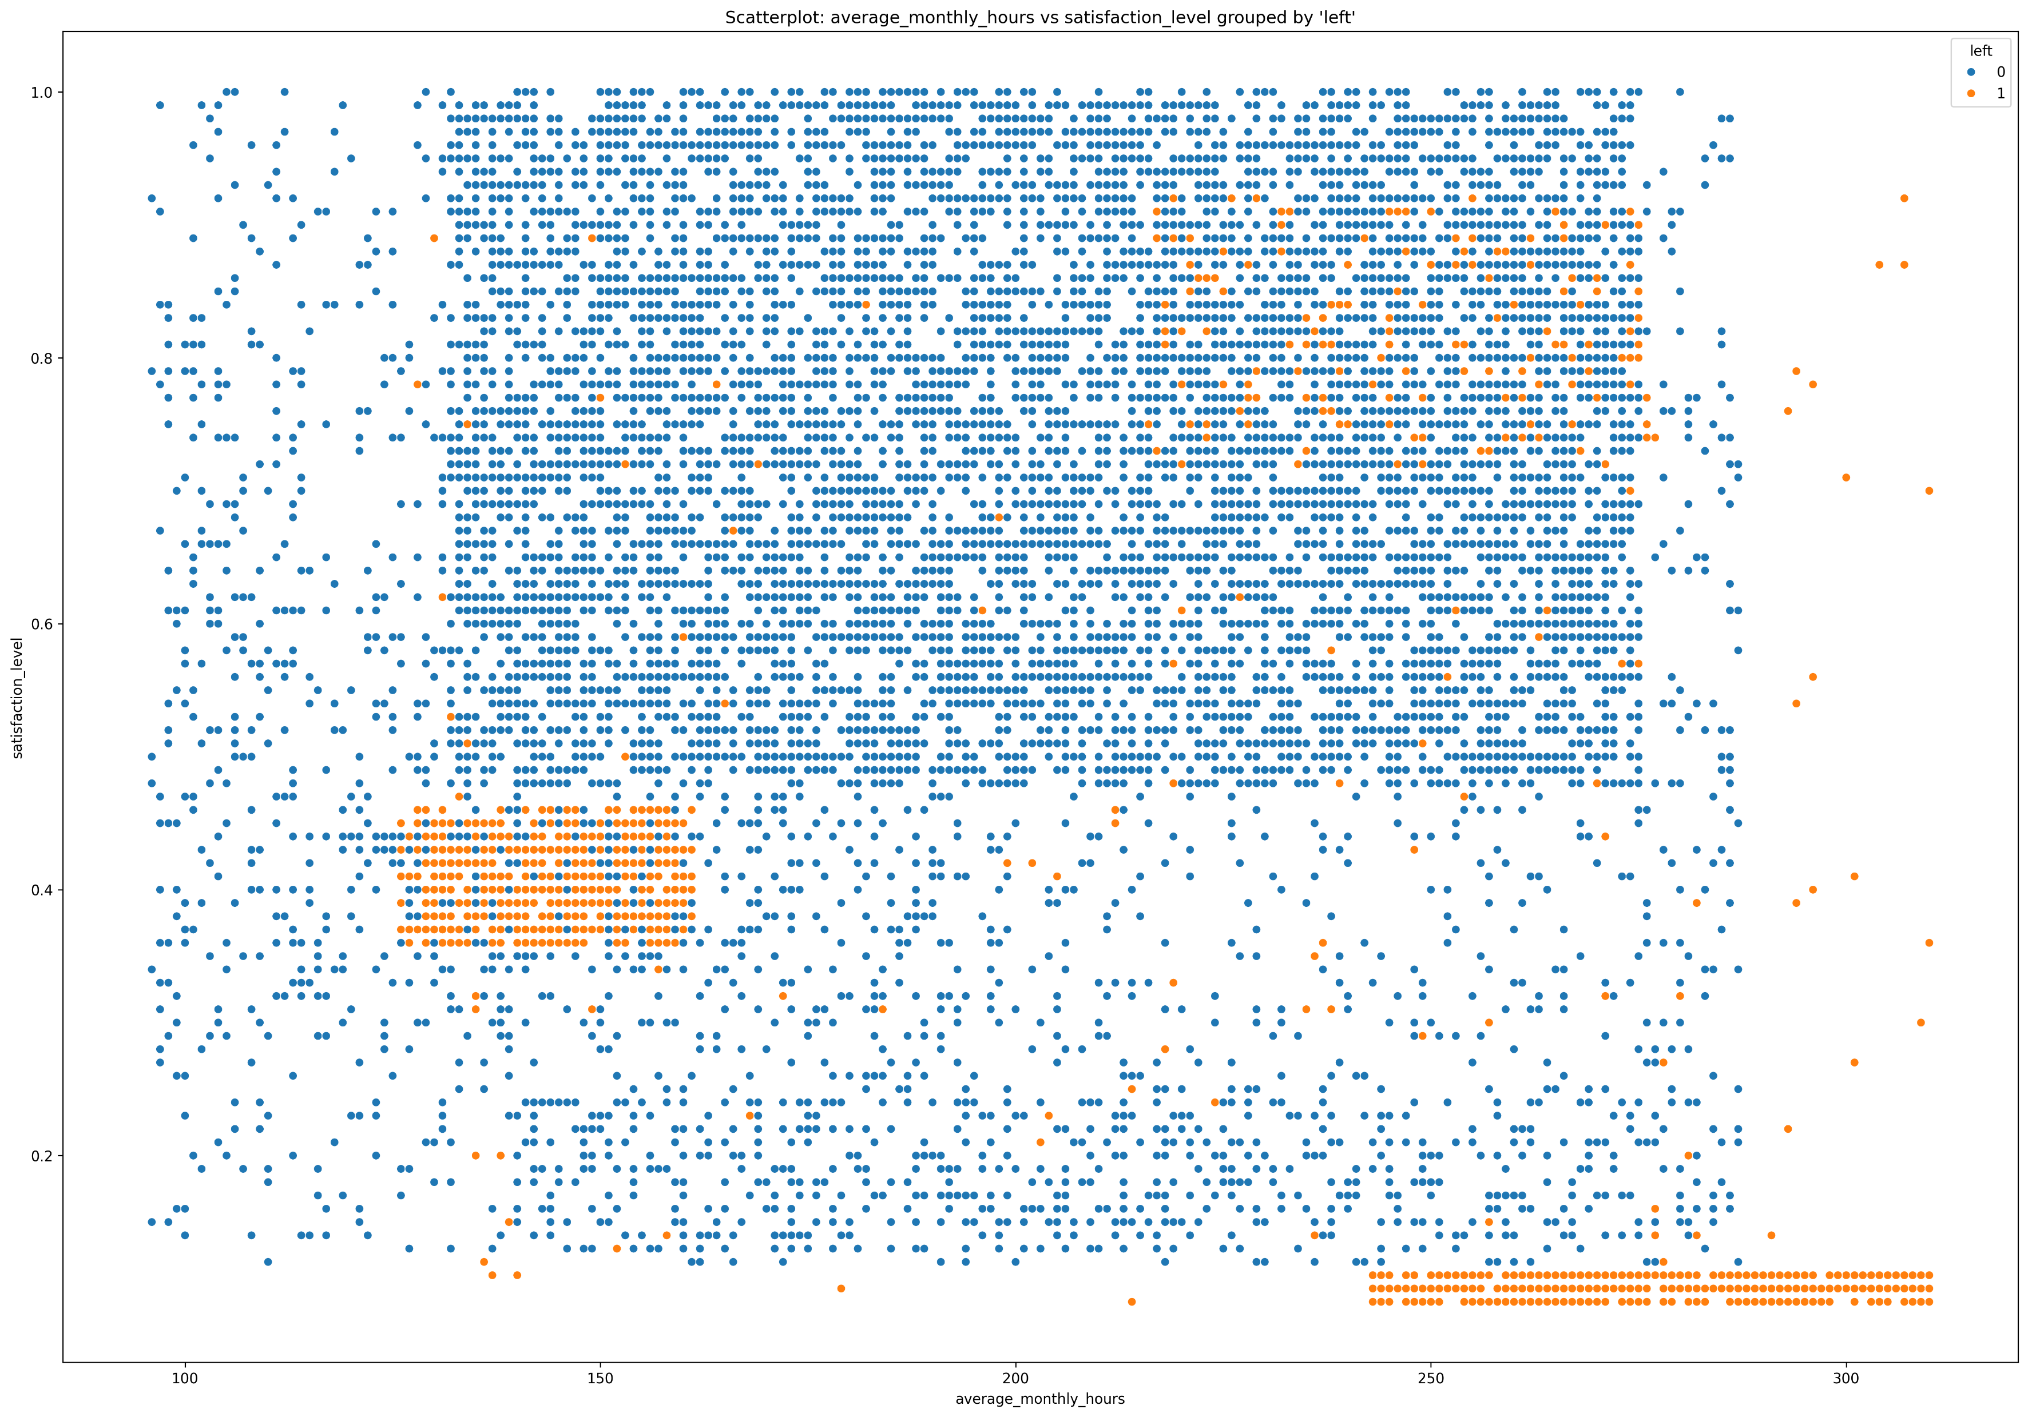
Employee Churn Analysis
Exploratory Data Analysis
- Scatterplot of
average_monthly_hours and
satisfaction_level.
- Normal working hours: 125-160
& satisfaction about 0.4. Employee
attrition is quite clear.
- Overworked: 240-315 & satisfaction:
0.1. All left.
- Overworked: 215-275 & satisfaction:
0.7-0.9. Employee attrition is
relatively low.

Slide 12
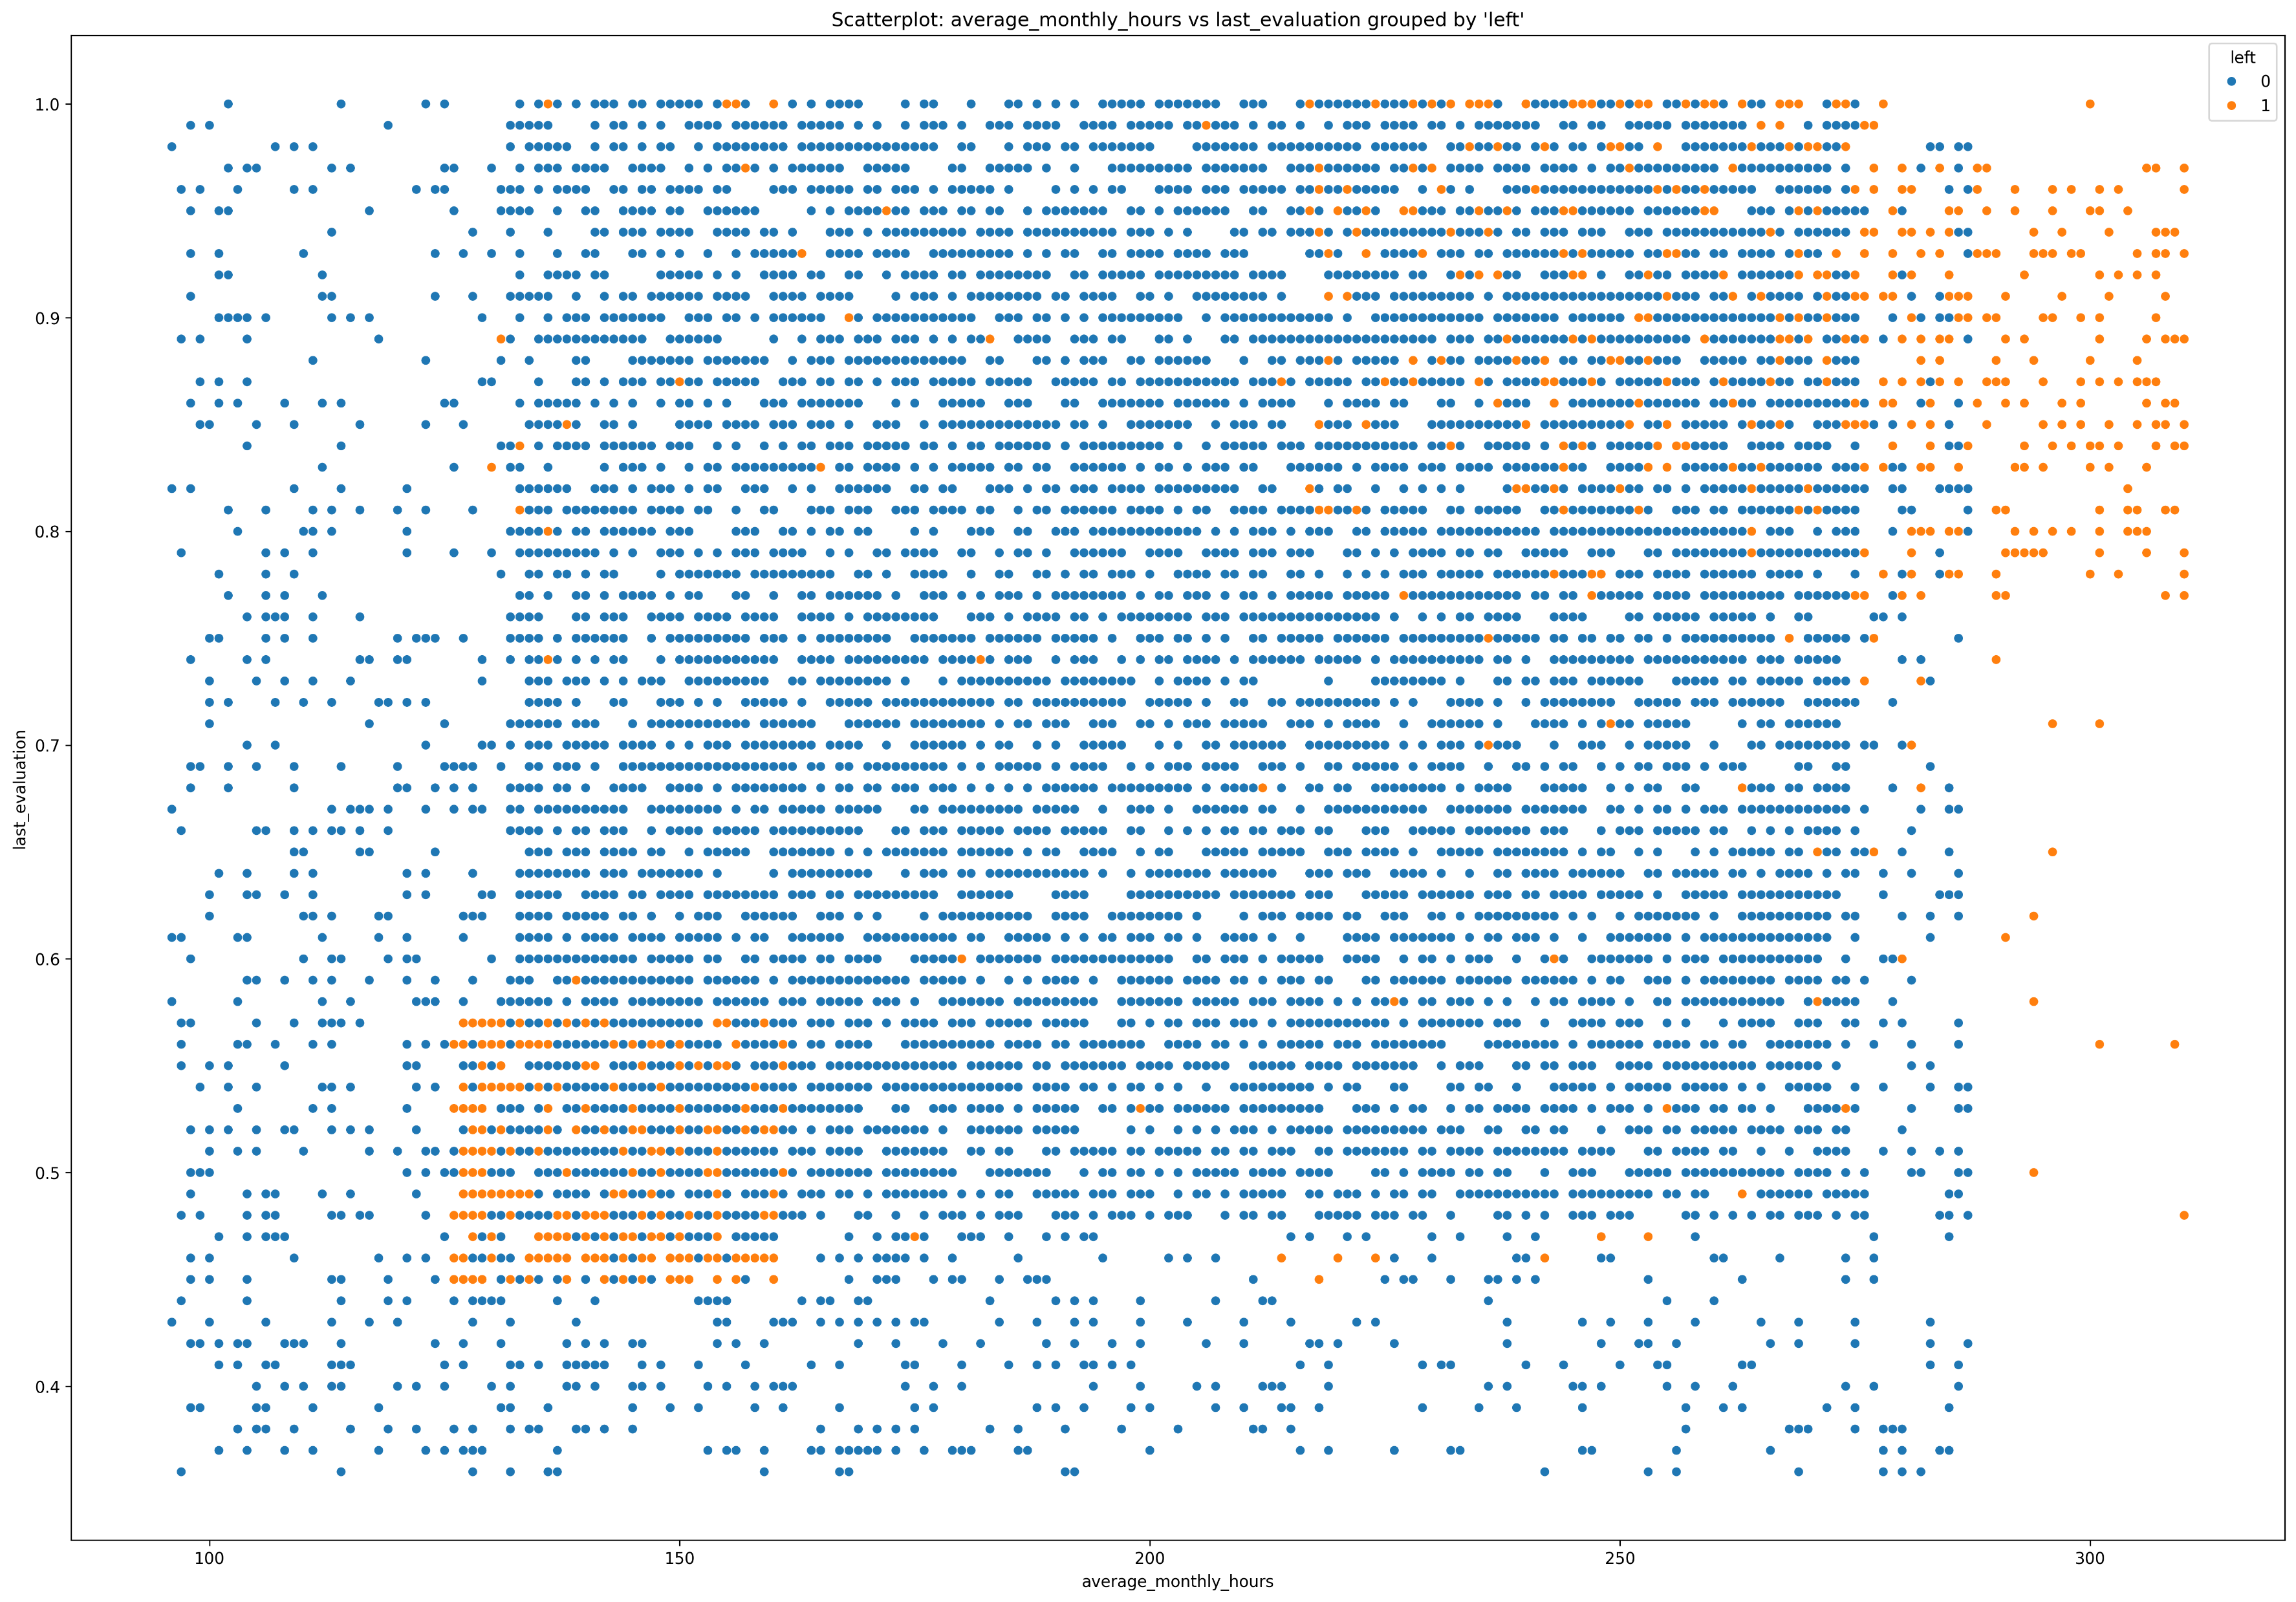
Employee Churn Analysis
Exploratory Data Analysis
- Scatterplot of
average_monthly_hours and
last_evaluation.
- Normal working hours: 125-160
& evaluation: 0.45-0.58. Employee
attrition is quite clear.
- Overworked: 215-315 & evaluation >
0.75. Employee attrition is relatively
low.

Slide 13
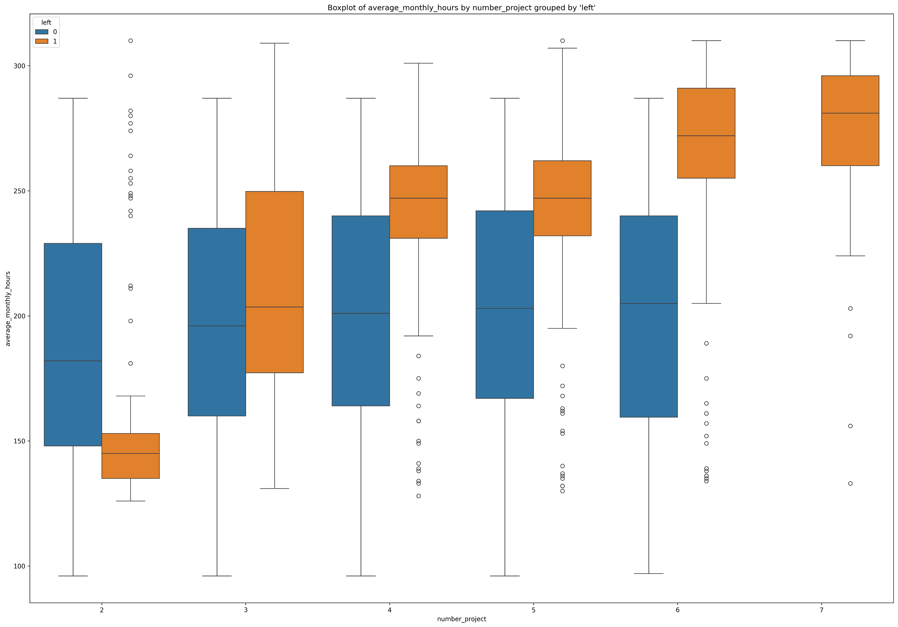
Employee Churn Analysis
Exploratory Data Analysis
- Boxplot of number_project and
average_monthly_hours.
- The churn rate increases linearly
between the 2 variables.
- With 3 projects, Employee attrition
is highest.
- With 7 projects, all left.

Slide 14
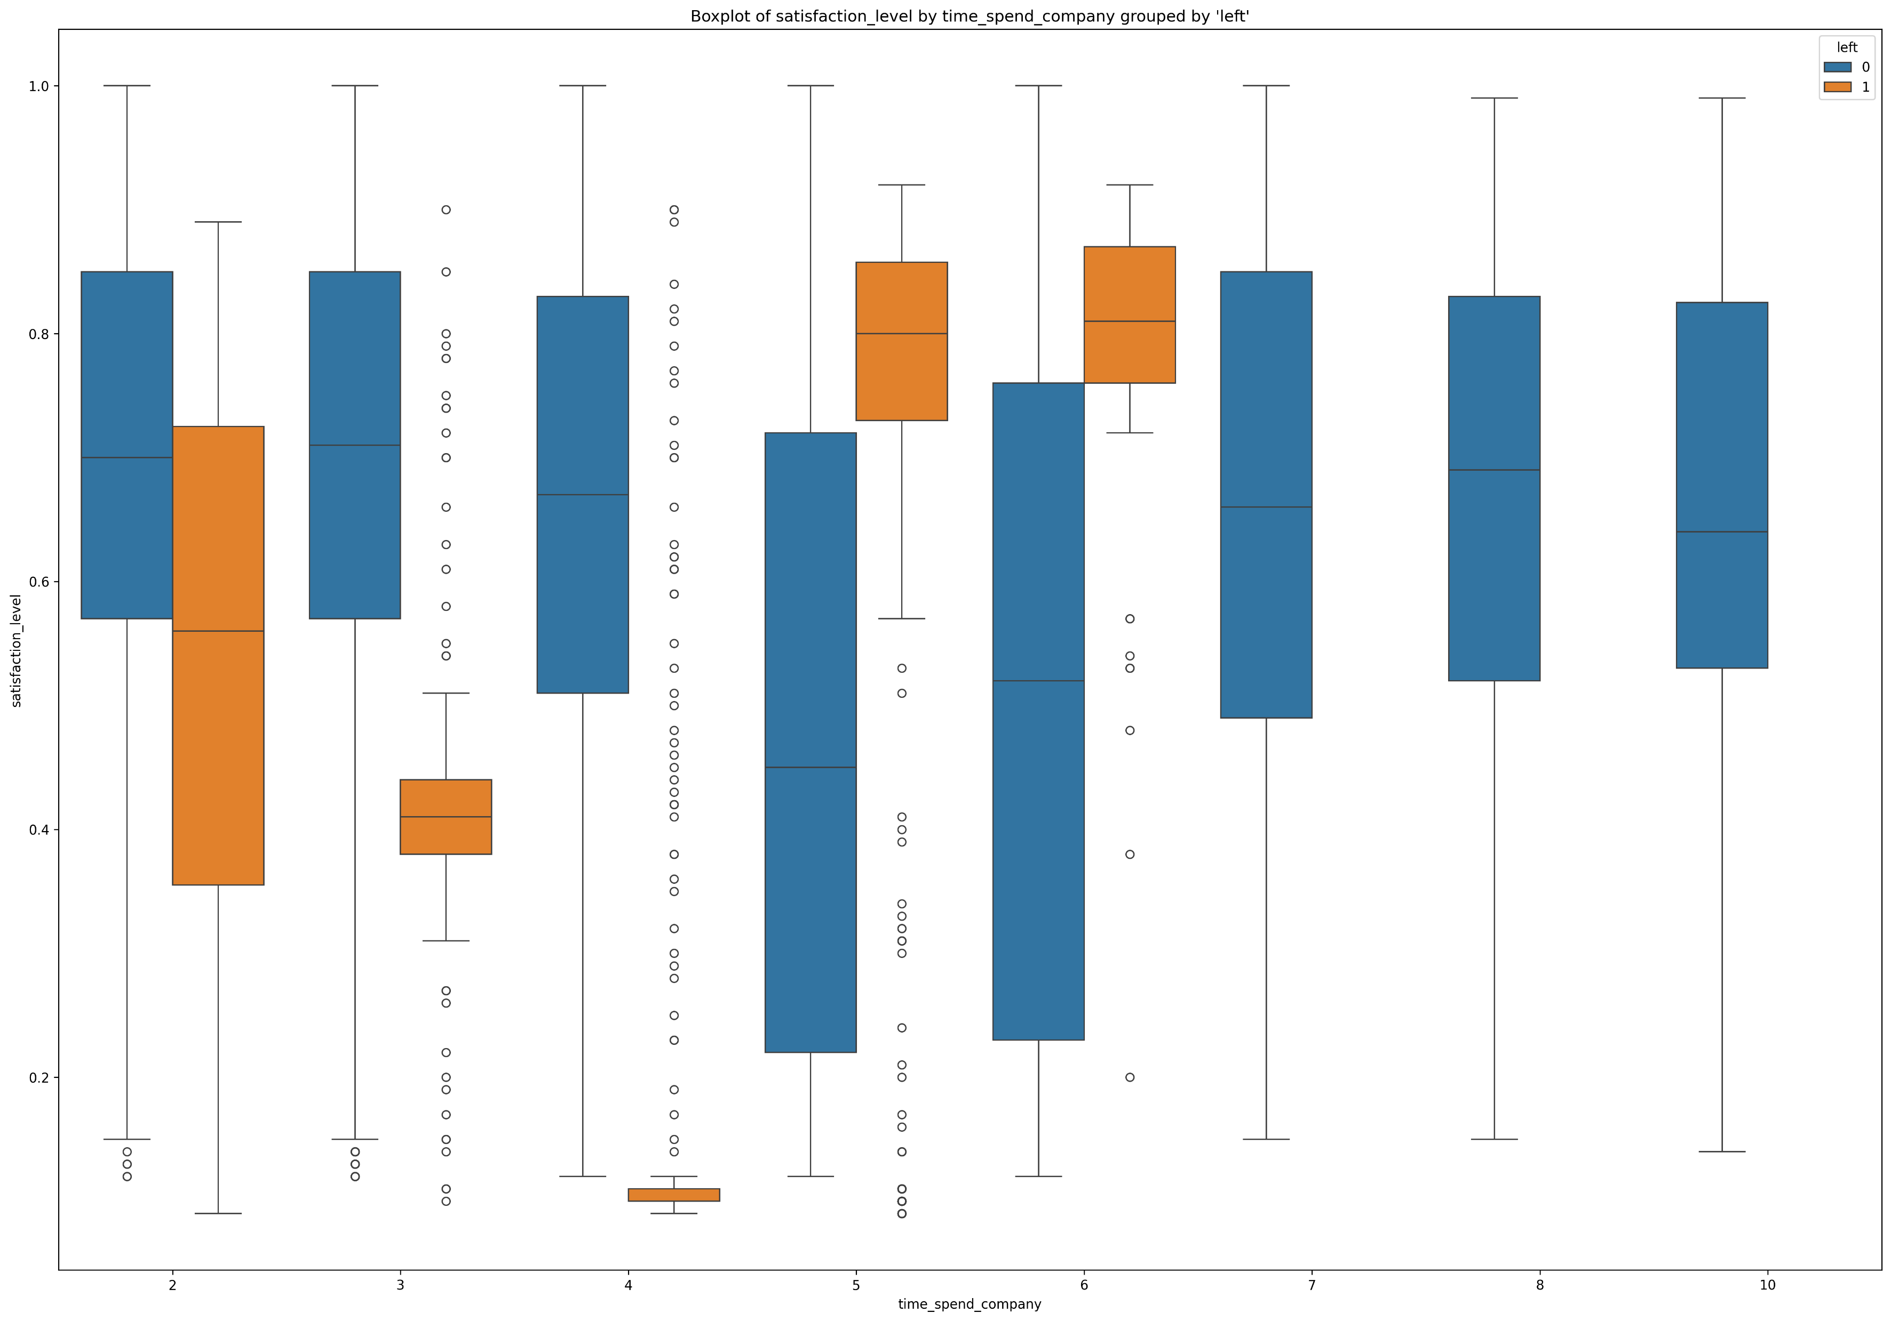
Employee Churn Analysis
Exploratory Data Analysis
- Boxplot of time_spend_company
and satisfaction_level.
- With 2 years-satisfaction: 0.35-0.72
employee attrition is highest
- With 5 & 6 years-satisfaction about
0.8 employee attrition is quite high.
- From 7 years onwards, no one
leaves.

Slide 15
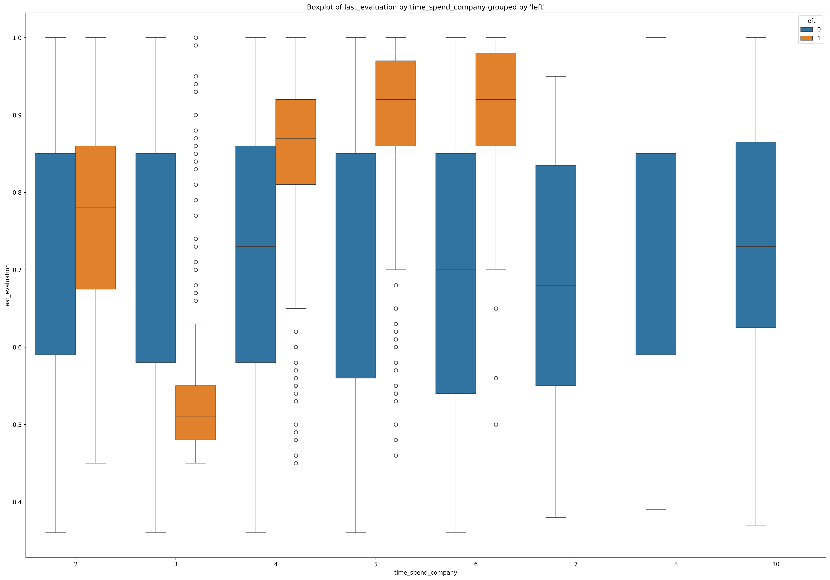
Employee Churn Analysis
Exploratory Data Analysis
- Boxplot of time_spend_company
and last_evaluation.
- A similar pattern can be observed
in slide 14.

Slide 16
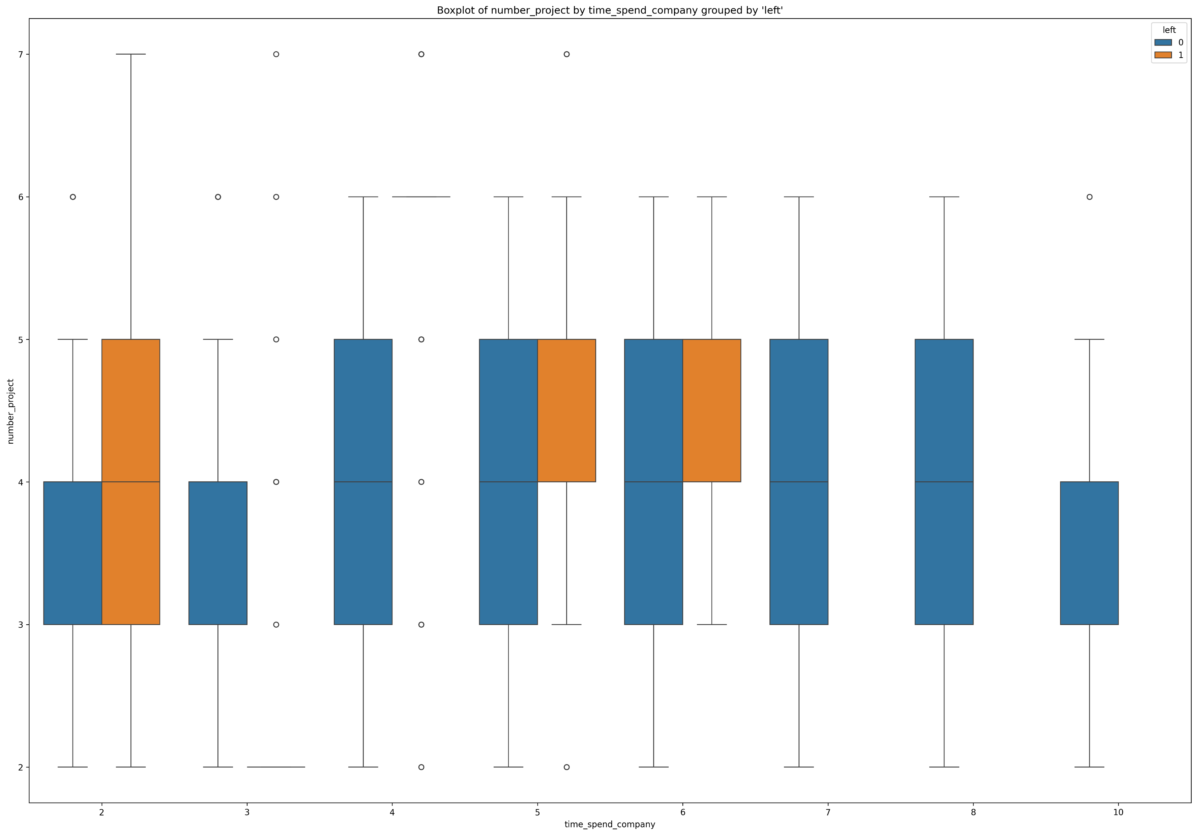
Employee Churn Analysis
Exploratory Data Analysis
- Boxplot of time_spend_company
and last_evaluation.
- With 2 years & 3-5 projects:
employee attrition is highest.
- With 5-6 years & 4-5 projects:
Employee attrition is quite high.
- From 7 years onwards, no one
leaves.

Slide 17
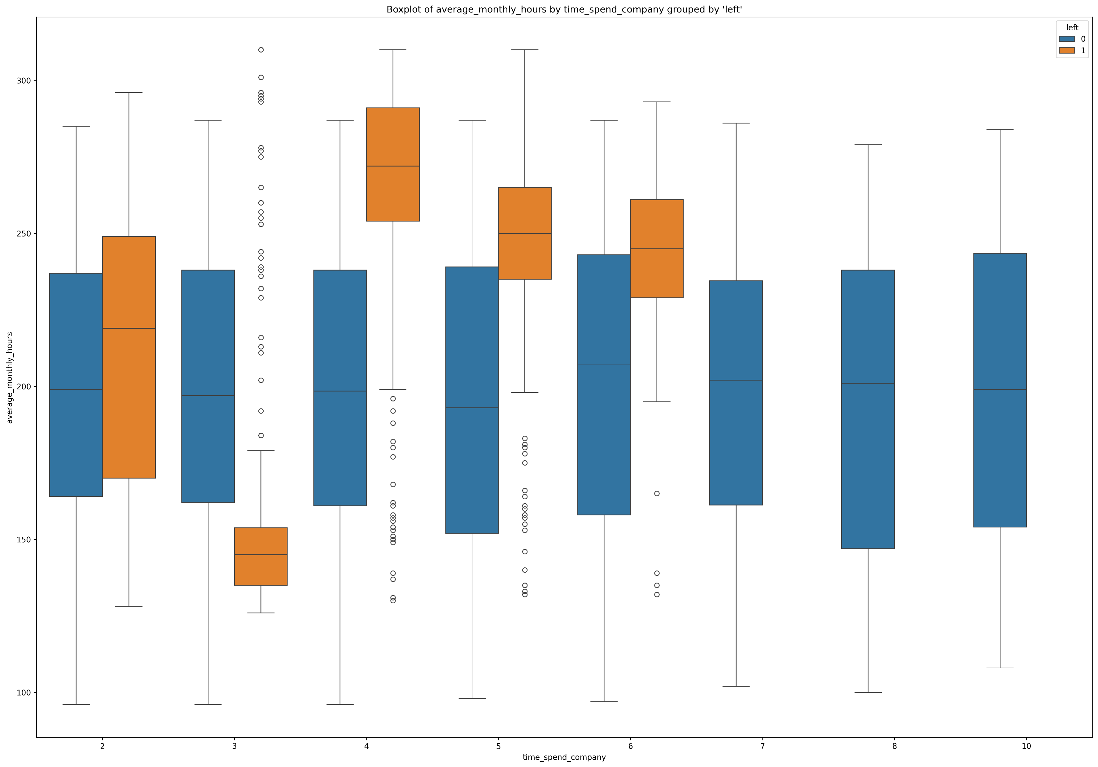
Employee Churn Analysis
Exploratory Data Analysis
- Boxplot of time_spend_company
and last_evaluation.
- With 2 years & overworked:
employee attrition is highest.
- With 4-6 years & overworked:
Employee attrition is quite high
- From 7 years onwards, no one
leaves.

Slide 18
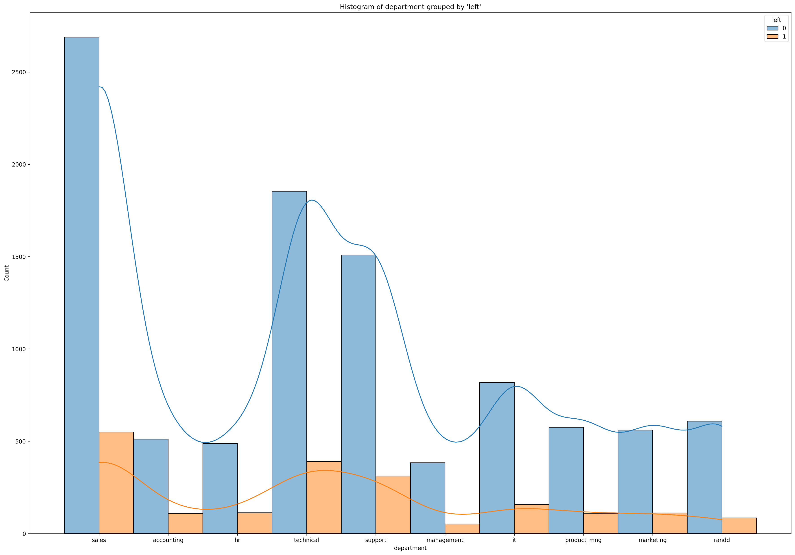
Employee Churn Analysis
Exploratory Data Analysis
- Histogram of department
- Sales department has the highest
attrition, followed by technical and
support departments.

Slide 19
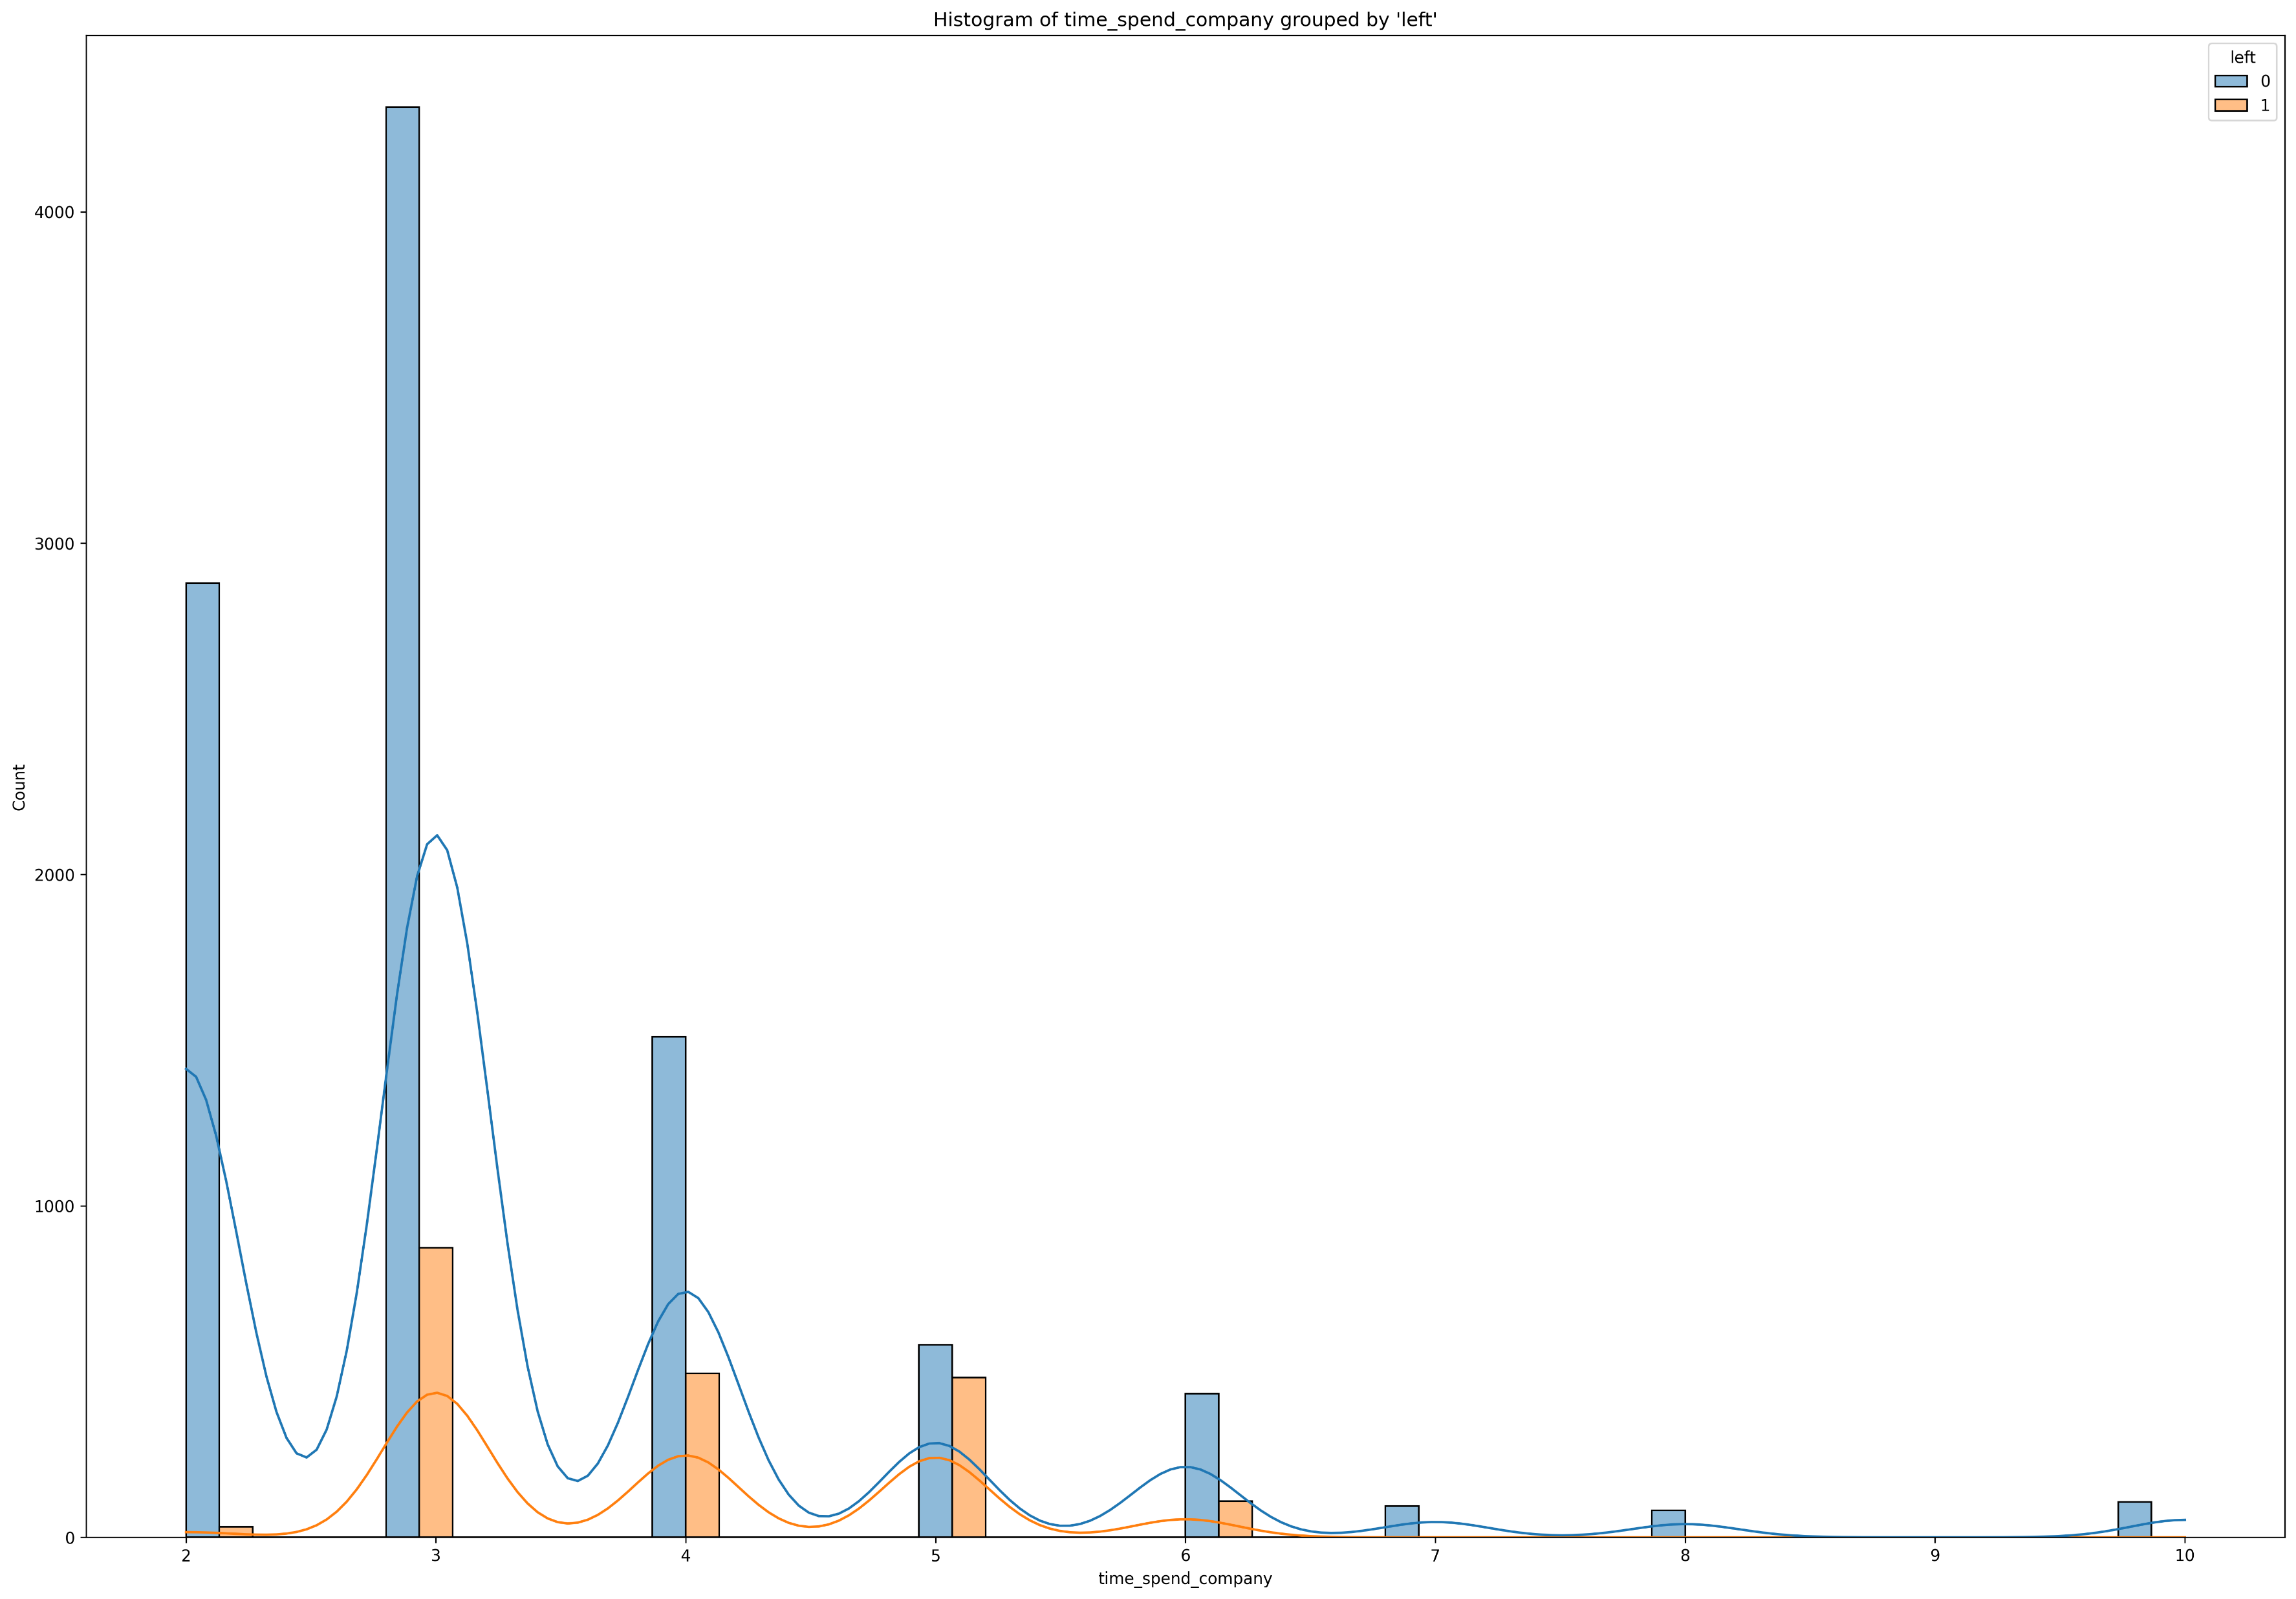
Employee Churn Analysis
Exploratory Data Analysis
- Histogram of
time_spend_company
- From 3-6 years, the rate of staff
attrition gradually decreases.

Slide 20
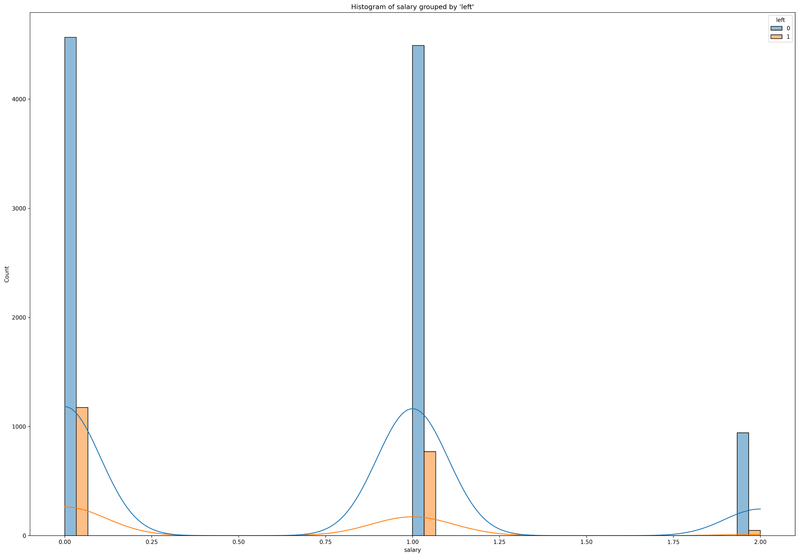
Employee Churn Analysis
Exploratory Data Analysis
- Histogram of salary
- The rate of staff attrition is
inversely proportional to the
salary level.

Slide 21
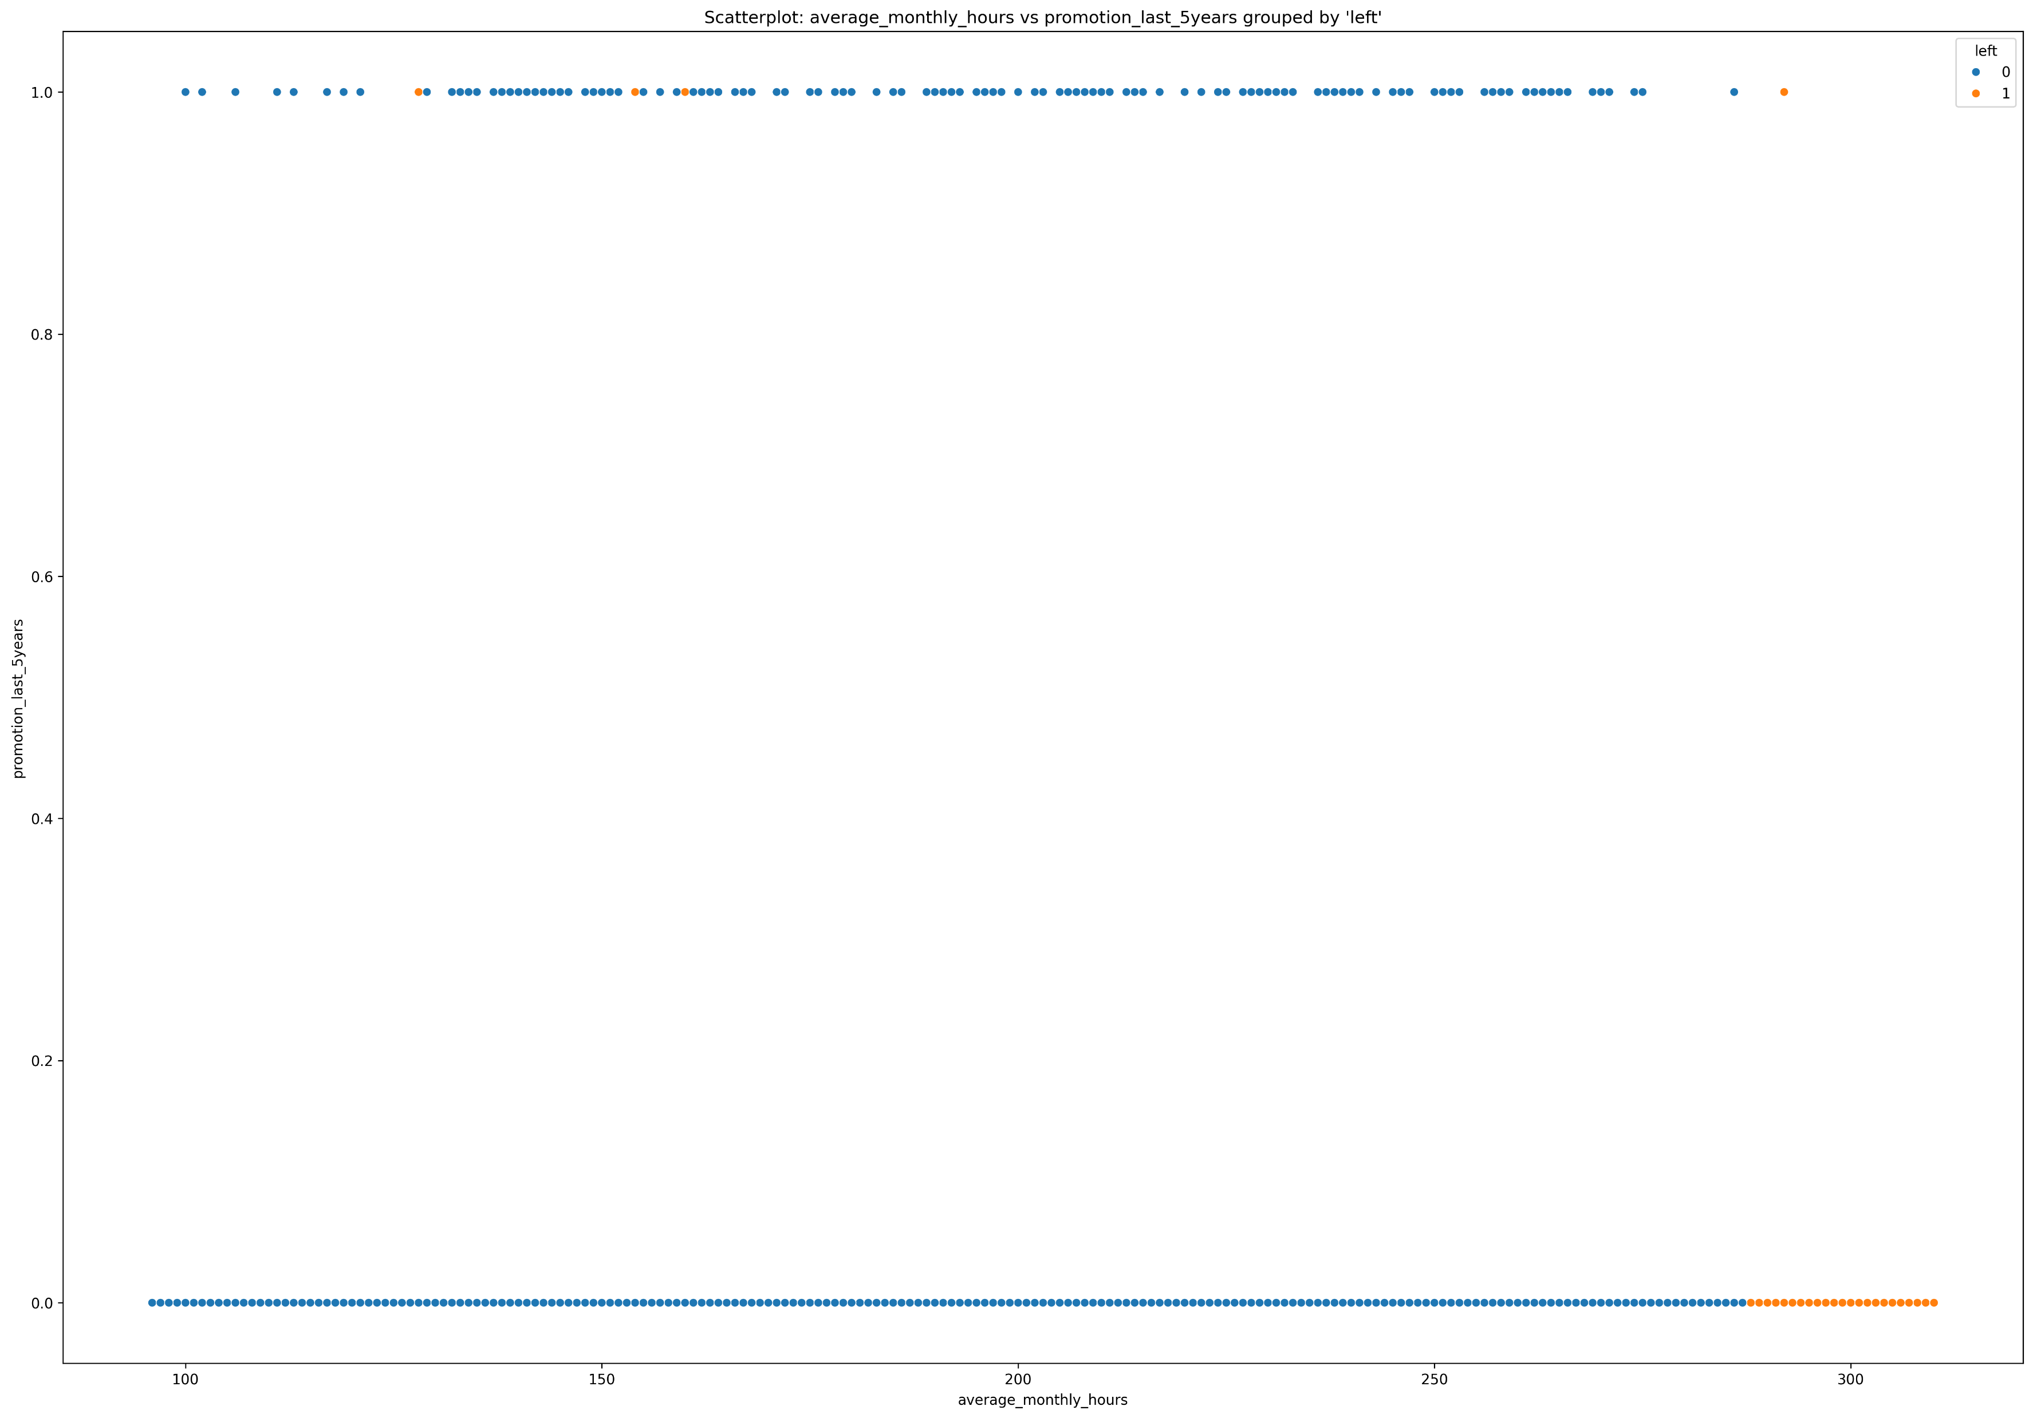
Employee Churn Analysis
Exploratory Data Analysis
- Scatterplot of average_monthly_hours
and promotion_last_5years
- Not promoted & Overworked:
>275 hours. Employee will leave.

Slide 22
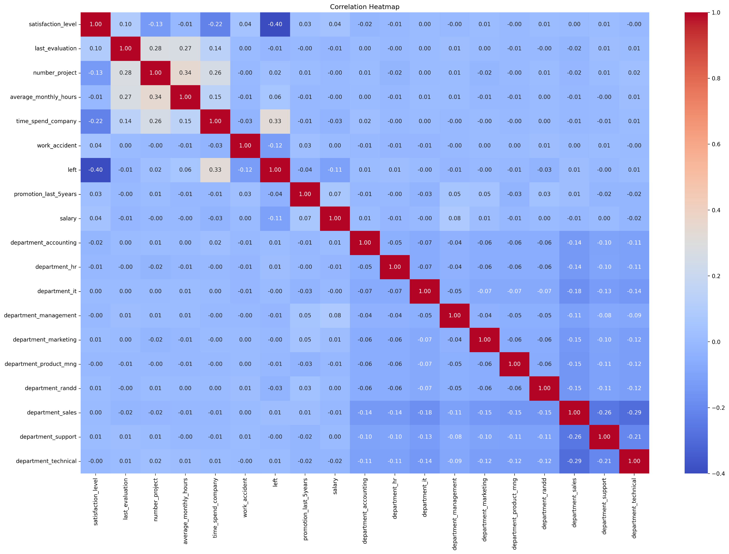
Employee Churn Analysis
Exploratory Data Analysis
- Correlation matrix of this dataset
- It confirms that number_project,
monthly hours, tenure, evaluation,
satisfaction all have some positive
correlation with each other.
- Additionally, an employee leaves
is negatively correlated with theirs
satisfaction, tenure, salary.

Slide 23
Employee Churn Analysis
2. Insights
- The average number of working hours per month of employees (Monday-Friday): 50 weeks * 40 hours / 12 months = 166.67 hours per month.
- Normal working hours < 167 hours, overworked >= 167 hours.
What’s likely to make the employee leave the company ?
1. Poor management | 2. Overworked | 3. Many projects | 4. Short-tenured | 5. High evaluation
6. Low satisfaction | 7. Low salary | 8. Not promoted | 9. Department-driven attrition | 10. No work accidents

Slide 24
Employee Churn Analysis
3. Recommendations
- Improve Workload Balance: Data indicates that employees with high workload_status show a significantly higher likelihood of leaving. Management may consider reviewing workload distribution or implementing task-rotation programs to reduce burnout.
- Increase Satisfaction Through Engagement Programs: The model identifies satisfaction_level as one of the strongest predictors of attrition. Introducing periodic feedback sessions, team-building activities, or career-development discussions may help improve employee satisfaction.
- Focus on Short-Tenure Employees: Employees with 3+ years in the company are more likely to leave, possibly due to stagnation or burnout. Providing growth opportunities, role rotation, or mentorship programs may help retain these employees.
- Investigate High-Risk Departments: Sales, Technical & Support departments show higher attrition importance scores. A deeper internal review by HR might identify department-specific issues.
- Review Compensation Policies for Critical Roles: Lower salary bands correlate with higher churn. HR may review compensation packages for key roles to stay competitive in the market.
- Use Early-Warning Indicators: Since satisfaction_level and workload_status are strong predictors, HR can build an early-warning system to flag at-risk employees and proactively intervene.

